Slide 1
Trade and competition at the WTO
Stela Rubínová
Research Economist
World Trade Organization
Nothing in this course is attributable to the WTO or its members, nor expresses any views on the correct interpretation of international rules.

Slide 2
Outline
The pro-competitive effects of trade liberalization
  Import competition as discipline on domestic market power
  Exposure to foreign competition forcing efficiency improvements
  Market expansion enabling economies of scale
The WTO framework – trade liberalization converted into rules
  The sources of global rules governing international trade
  Basic structure of rules
  Global rules enforcement
The mutually supportive role of trade and competition policies
  Trade liberalization alone does not guarantee optimal competition levels
  Different levels of national competition enforcement can lead to uneven playing field
  WTO rules allow for flexibilities to limit foreign competition – trade remedies

Slide 3
The pro-competitive effects of trade liberalization
Nothing in this course is attributable to the WTO or its members, nor expresses any views on the correct interpretation of international rules.

Slide 4
Trade liberalization
Trade liberalization
the process of reducing or eliminating barriers to international trade to allow goods and services to move more freely across borders
  Tariffs
  Quotas
  Regulations
Notes:
Interconnections in how we produce the goods and services that we consume.
Integration of markets that used to be separated by distance, language, regulations and trade policy barriers.
As a result there is more trade, more specialization
This has led to
Lower price levels and supported low inflation rates
Diffusion of technology and income convergence of developing countries
Interdependence (countries have stake in each others’ success)
Access to more suppliers and more customers (good for economic resilience)
BUT ALSO
Adjustment in each economy as more specialization leads to expansion of some firms and contraction of others
More exposure to global competition without a global competition/regulatory authority ensuring a level playing field
Excessive production concentration in some products, which may increase global risks from both natural and (geo)political shocks

Slide 5
Global trade, 1970 – 2022, in % of global GDP
Trade in intermediate and final products, 1995 – 2018,
in 1000 USD
Source: World Bank data.
Source: OECD Statistics, Trade in Value Added Database.
Notes:
We consume many more goods and services produced abroad.
It is not only consumption. In fact, most international trade is between firms, trading intermediate inputs into production such as parts and components, primary inputs (fuels) and materials.
The unprecedented growth in trade was largely driven by what we call production unbundling – the increased internationalization of the production process itself.

Slide 6




Trading across borders has become easier
Trade costs, index 1996=100
Transport and travel
Information, communication and transaction costs
Trade policy, customs procedures and regulatory barriers
Institutional quality and governance
Source: WTO Trade Cost Index, www.tradecosts.wto.org

Slide 7
Tariff rate, in %
Import tariffs
Source: World Bank data. Applied tariff rate, weighted average, all products.
Notes:
Discussion of NTMs

Slide 8
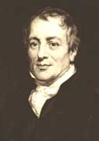
Why do countries trade?
The Ricardian Model
Even if one country is more productive in absolute terms in the production of all goods, mutually beneficial trade is possible
Notes:
Ricardo: (1772-1823) son of a banker who migrated from the Netherlands to London. Became rich trading on the London stock exchange and retired while still young. As an economist, focused on abstract theory, analysing growth and income distribution.
Ricardo gave the example of Great Britain and Portugal producing cloth and wine.
Let’s suppose Portugal is more productive in wine and Great Britain in cloth. It will obviously make sense for each country to specialise and import the other good. If one country is better at producing cloth and another one at producing wine, and both like to consume both then there is clearly space for trade.
Plausibly, Portugal could be more productive in both goods. That’s at the heart of Ricardo’s insight - as long as the productivity edge is larger in wine, it will make economic sense for Portugal to specialize

Slide 9
Productivity
The amount of output per unit of input
Country A is more productive than country B if it can produce more goods with the same amount of resources = country A has better technology
You can also think of it as producing the same amount but better quality

Slide 10
Comparative advantage
A country has a comparative advantage in producing those goods in which its productivity edge over the other country is greater.
"Do what you do best, trade the rest"
Trade is driven by differences in relative prices.
Each country specializes in the production with a low relative price compared to the other country.
Notes:
The classical theory of comparative advantage in 1817.
Prices are equal to marginal costs.

Slide 11
Sources of gains from trade
Recognition that economic resources are scarce and limited in all countries.
Allowing countries to allocate their resources (specialize) in the economic activities in which they have a comparative advantage and then rely on trade for the activities in which they have a comparative disadvantage expands the size of global production.
Trade allows for all countries to potentially consume beyond what they can individually produce

Slide 12
Gains from trade
The key channel is the difference in relative productivities and therefore prices.
Welfare increases because the consumption basket becomes more affordable
Gains from trade increase with differences in relative productivities.
If there is trade neither country is worse off compared to a scenario without trade.

Slide 13
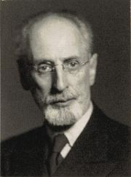

What are the sources of comparative advantage?
The Heckscher-Ohlin model
While trade is partly explained by differences in technology, it also can be explained by differences in resources across countries
Notes:
In Ricardo’s example, Great Britain has superior technology in cloth while Portugal in wine – but what gives rise to this pattern?
Two Swedish economists. Theory published in 1933.

Slide 14
Differences in endowments
Think of traded products as a bundle of production factors – natural resources, labor, and capital
The model shows that international differences in factors of production create comparative advantage as:
  Countries have relative abundance of factors of production.
  Production processes use factors of production with relative intensity.
Each country specializes in the production that requires relatively more of the factor with which it is well endowed.

Slide 15






Differences in endowments
2 countries, same technology
Different “endowments” of production factors
  Workforce composition – high-skilled and low-skilled workers
  The EU is endowed with relatively more high-skilled workers than Bangladesh
2 goods
  Pharmaceuticals and textiles
  Compared with the production of textiles, the production of pharmaceuticals is relatively skill intensive

Slide 16
Factor abundance and the pattern of trade
 | EU | Bangladesh
No trade | Skills are relatively abundant: Pharmaceuticals are relatively cheap; Textiles are relatively expensive | Skills are relatively scarce: Pharmaceuticals are relatively expensive; Textiles are relatively cheap
Free trade
Change in production structure

Slide 17
Factor abundance and the pattern of trade
 | EU | Bangladesh
No trade | Skills are relatively abundant: Pharmaceuticals are relatively cheap; Textiles are relatively expensive | Skills are relatively scarce: Pharmaceuticals are relatively expensive; Textiles are relatively cheap
Free trade | Export pharmaceuticals; import textiles | Import pharmaceuticals; export textiles
Change in production structure | Pharmaceutical industry grows; textile industry shrinks | Textile industry grows; pharmaceutical industry shrinks

Slide 18
Sources of gains from trade
Specialization according to comparative advantage
Comparative advantage is driven by relative differences in the availability of production factors - labour, human capital (skills) and physical capital
Gains from trade increase with differences in factor endowments.

Slide 19

How to explain trade among similar countries?
The Krugman model
Traditional approaches cannot explain why we observe extensive trade among similar countries and the importance of intra-industry trade
Notes:
So far, the theories are based on country differences. How come then that we observe trade between Germany and France?
Paul Krugman received a Nobel prize in economics in 2008 for this work.

Slide 20

Importance of intra-industry trade
14.8 bn
7% of German car imports come from France
7% of German car exports go to France
Germany
France
10.6 bn
Notes:
In France, more than three quarters of manufacturing trade can be regarded as intra-industry trade.
Krugman’s theory rests upon an important concept – product differentiation.
Previous theories abstract from product differentiation – a wine could be objectively better or worse but there were no varieties and therefore no preferences for different producers/locations. In reality, there are many different varieties of wine and each consumer may prefer a different variety. This is in contrast to e.g. electricity which is a homogeneous product.
The existence of varieties is important for market competition and thus the price level – the following slides provide a primer in how markets work – how demand and supply together determine the market price.

Slide 21
Differentiated products and economies of scale
Economies of scale
Products are differentiated & consumers like product variety
Each market can sustain an optimal number of firms
  Trade-off between economies of scale that favour a market with few large firms and consumers’ preference for product choice which favours a market with many small firms.
Notes:
Example:
The services of interior designers
– no fixed costs of production, all you pay for is their time, aka labour.
- every consumer has different taste – the more designers there are, the more likely each consumer is to find a good match => consumers favour a market with many designers
- by-product: the more designers there are, the fiercer the competition and the lower the price each of them can charge. But since their only production cost is their time, it will be profitable for them to enter the market as long as the opportunity cost of their time is lower (we assume it is the same for all designers).
Now assume that each interior designer needs to rent a studio, i.e. they have a production cost that they have to pay irrespective of how many services they sell. It will be profitable for them to enter the market only if they can sell a certain minimum amount of their services (that is the amount that at least covers the rent for the studio) & the more a designer produces the lower its average production cost (the rent is more and more diluted) => without product differentiation the market would tend towards monopoly.

Slide 22
Krugman economy
Country A
Country B

Slide 23
The impact of trade liberalization
Integrated market
Notes:
Consumers become more price sensitive because there are more varieties => increased competition drives the price down.
Some firms will exit because the lower revenues do not cover costs anymore.
With the same amount of global resources production grows because less resources are “wasted” on fixed costs.

Slide 24
Gains from trade between similar countries
Consumers have wider product choice and become more price sensitive.
Each firm has access to additional markets which allows it to exploit economies of scale and reduce average costs
The increased competition drives some firms out of the market while others expand
Consumers have wider product choice at lower prices

Slide 25

Why do only some firms export?
The Melitz Model
Trade liberalization allows the most productive firms to expand while it forces the least productive firms to exit
Notes:
Krugman’s theory won him the Nobel prize in economics. It can explain aggregate, industry-level trade patterns. However, not all firms in an industry react the same to trade liberalization.

Slide 26
Exporting is rare and very concentrated

Slide 27
Exporting is rare and very concentrated

Slide 28
Krugman model + +
The same set up as in the Krugman model
+ firms differ in their productivity
  Each firms sells a different variety but now some firms have lower production costs (e.g. better technology) than others
+ exporting has its own fixed costs
  Think investment in marketing and advertising in each foreign market or the cost of complying with different regulations in each country

Slide 29
Melitz economy
Country A
Country B
Notes:
Size of a firm corresponds to its productivity – more productive firms capture larger share of the market and become bigger.
Productivity can be lower production costs or better quality for the same cost.

Slide 30
The impact of trade liberalization
Integrated market
Notes:
Most productive firms will expand and export (the new export market makes up for a tougher competition from imports at home)
Less productive firms will shrink in the face of import competition (they don’t export because their scale is too small to pay the fixed cost of exporting).
The least productive firms will exit the market because of import competition and competition for production factors from the expanding exporting firms.

Slide 31
Gains from trade when firms differ in their productivity
Productivity effect: Reallocation of resources and market shares from less to more productive firms.
The average industry productivity increases and prices decline

Slide 32
Gains from trade: recap
    More efficient allocation of resources (across and within sectors)
    Scale economies
    Increased competition
    Access to a larger variety of products
    Higher real income (lower prices) and larger product variety
Notes:
Allocation of resources to more productive sectors and to more productive firms
Less resources spent on fixed costs
Lower mark-ups

Slide 33
Gains from trade: empirical evidence
  China’s WTO entry reduced U.S. manufacturing price indexes by 7.6% between 2000 and 2006 (Amiti, Dai, Feenstra and Romalis, 2018)
  Access to imports of intermediate inputs increase firm productivity, especially through access to better technologies and cheaper input prices
  Overall, Feyrer (2019) estimates that a 10 percent increase in trade leads to 5 percent increase in national income
Notes:
Amiti, Mary & Dai, Mi & Feenstra, Robert C. & Romalis, John, 2020. "How did China's WTO entry affect U.S. prices?," Journal of International Economics, Elsevier, vol. 126(C)
Keller, Wolfgang, 2002. "Trade and the Transmission of Technology," Journal of Economic Growth, Springer, vol. 7(1), pages 5-24, March.
Mary Amiti & Jozef Konings, 2007. "Trade Liberalization, Intermediate Inputs, and Productivity: Evidence from Indonesia," American Economic Review, American Economic Association, vol. 97(5), pages 1611-1638, December.
Kasahara, Hiroyuki & Rodrigue, Joel, 2008. "Does the use of imported intermediates increase productivity? Plant-level evidence," Journal of Development Economics, Elsevier, vol. 87(1), pages 106-118, August.
Nishioka, Shuichiro & Ripoll, Marla, 2012. "Productivity, trade and the R&D content of intermediate inputs," European Economic Review, Elsevier, vol. 56(8), pages 1573-1592.
Pinelopi Koujianou Goldberg & Amit Kumar Khandelwal & Nina Pavcnik & Petia Topalova, 2010. "Imported Intermediate Inputs and Domestic Product Growth: Evidence from India," The Quarterly Journal of Economics, Oxford University Press, vol. 125(4), pages 1727-1767.
James Feyrer, 2019. "Trade and Income—Exploiting Time Series in Geography," American Economic Journal: Applied Economics, American Economic Association, vol. 11(4), pages 1-35, October.

Slide 34
Income convergence of developing economies and their trade participation
Source: World Trade Report 2024
Notes:
A striking feature of the last 30 years since the creation of the WTO is income convergence between low- and middle-income economies and high-income economies.
GDP per capita in low- and middle-income economies tripled, while the global GDP per capita increased by 65%
However, convergence has slowed since the great financial crisis and even reversed during the COVID-19 pandemic
This trade convergence led to a significant reduction of poverty.
Share of people living in extreme poverty in low- and middle-income economies fell from 40% to 11%
While their share of global trade doubled from 16% to 32%
As can be seen in the figure, the correlation between speed of convergence and trade participation is striking.
This finding aligns with econometric evidence showing that trade reforms in developing economies have boosted economic growth by 1 to 1.5 percentage points.

Slide 35
The WTO framework – Trade Liberalization Converted into Rules

Slide 36
Globalization converted into rules
Sources of rules – agreements between States
World Trade Organization (WTO) treaties – 166 Members
  Multiple treaties (goods, services, IP); single undertaking
Free Trade Agreements (FTAs) – bilateral/plurilateral (every WTO Member has at least one FTA); over 400 FTAs
  Some FTAs more limited (e.g. goods only)
  FTAs increasingly “comprehensive” – goods, services, IP, digital, enviro/labour
International Investment Agreements (IIAs) – mostly bilateral, 3000 IIAs
  FTAs increasingly encompass an “investment chapter”

Slide 37
Globalization converted into rules
What are the rules that seek to embody globalization?
WTO obligations:
  Prohibit existing protectionist measures, except import tariffs for goods / market access for services
  Lock in negotiated liberalisation in import tariffs/services market access, and progressively liberalise over time through negotiations
  Prevent governments from adopting new protectionist measures
FTA obligations:
  Deeper liberalisation of import tariffs on goods / services market access
  Also increasingly liberalising capital flows – investments – on non-discriminatory
IIA obligations:
  Protect capital after invested
  Expropriation; fair & equitable treatment; non-discriminatory treatment

Slide 38

Globalization converted into rules
Cannot ban/restrict imports
Cannot impose import tariffs above agreed limits
Cannot ban service suppliers from entering your market (within agreed sectors)
Cannot discriminate in favour of your own manufacturers/service suppliers/capital
Cannot discriminate between manufacturers/service suppliers/capital from different countries
Cannot impose domestic content requirements/advantages

Slide 39

Globalization converted into law
ENFORCEMENT
WTO obligations enforceable through WTO dispute settlement system
  State-State litigation with independent adjudicators, binding judgments, and trade sanctions as outcome
  Two-tiered system – Appellate Body shutdown
FTA obligations enforceable through FTA-specific arbitration mechanism
  Similar to WTO; only one tier
IIA obligations enforceable through investor-State arbitration
  Binding arbitration, monetary damages, investors have standing

Slide 40
The mutually supportive role of trade and competition policies

Slide 41
The unfinished WTO competition agenda
WTO members have not agreed on a set of rules governing national competition enforcement, state owned enterprises or government subsidies (except export subsidies and agriculture subsidies) that may distort market competition
Trade liberalization increases exposure to global competition and may lead to the rise of companies with global dominant position but there is no “global competition authority”
Competitive services sectors, such as distribution, transport and telecom services, are a prerequisite for gains from international trade

Slide 42
Different competitive environments
Competition law is territorial - enforcement stops at borders
  Exporting firms may engage in predatory pricing, price discrimination, or exclusionary practices abroad, beyond reach of domestic competition authorities
Home market power may have negative spillovers to foreign markets, especially in sectors with large economies of scale
  Difference in the degree of trade liberalization and/or differences in competition enforcement may lead to difference in home market power
Trade liberalization will not necessarily alone produce a level playing field
  The presence of SOEs may limit the pro-competitive effect of trade liberalization
  The of domestic policy instruments, such as subsidies, may provide competitive advantage to subsidized firms
Notes:
Certain competition policies on telecommunications are included in the Basic Telecoms Reference Paper and are thus addressed by the GATS and services trade negotiations

Slide 43
Effective competition policy is key to inclusive gains from trade
Effective competition policy and enforcement can play a pivotal role in promoting inclusiveness across and within economies.
Robust competition policies are critical in the digital age. The digital sector is particularly prone to market concentration, due to substantial economies of scale and scope and strong network effects
International cooperation on competition policies ensures a level playing field for businesses across borders, preventing anti-competitive practices and fostering fair competition.
Regulatory cooperation can be complemented with technical assistance activities focused on the intersection of trade and competition policy, particularly in response to the needs of developing economies.

Slide 44
Tools for managing unfair foreign competition
WTO rules include flexibilities to limit unfair foreign competition – “trade remedies”
Anti-dumping measures in response to injury from dumped imports
Anti-subsidy (“countervailing”) measures in response to injury from subsidized imports

Slide 45
Sources of rules governing trade remedies
Trade remedies allow for “exceptions” to WTO/FTA obligations (e.g. tariff bindings) through specific WTO treaties:
  Anti-Dumping measures: Agreement on Implementation of Article VI of GATT 1994, “Anti-Dumping Agreement”
  Anti-subsidy (“countervailing”) measures: Agreement on Subsidies and Countervailing Measures, “Subsidies Agreement”
Countries have domestic legal frameworks to implement these legal instruments
  Must conform with WTO law but need not replicate; can be more specific or prescriptive; scope for innovation

Slide 46
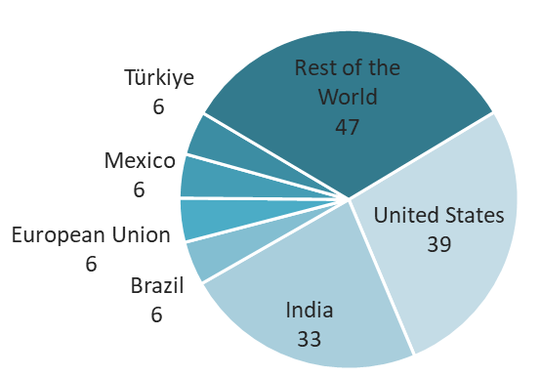
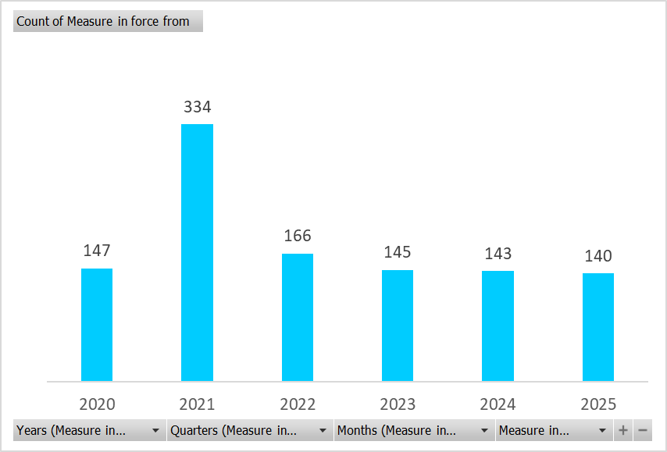
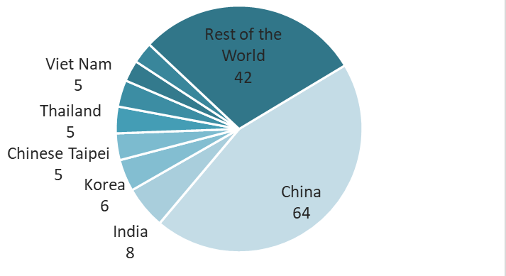
Anti-dumping measures
Number of new measures imposed globally
Number of new measures by importing economy
Number of new measures by exporting economy
Source: WTO Trade Remedies Data Portal. Data for 2025 are until June.

Slide 47
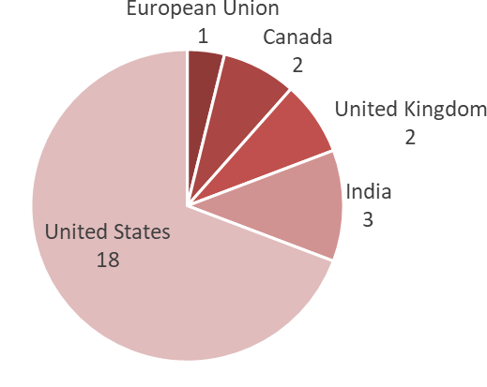
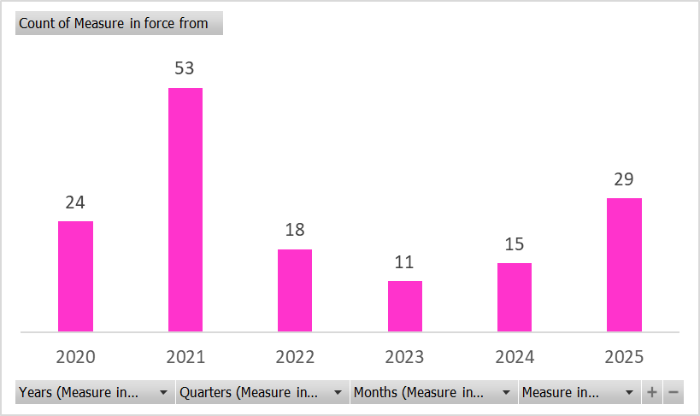
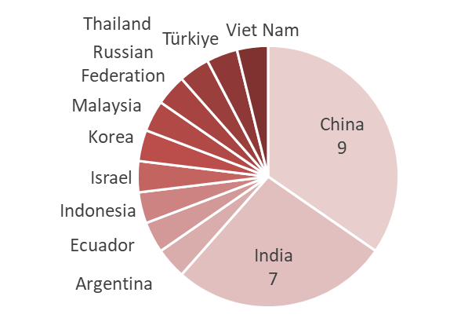
Countervailing measures
Number of new measures imposed globally
Number of new measures by importing economy in 2023-4
Number of new measures by exporting economy in 2023-4
Source: WTO Trade Remedies Data Portal. Data for 2025 are until June.

Slide 48
Conclusions
Trade liberalization can increase competition in the domestic market, leading to lower consumer prices and larger product choice
WTO rules are designed to lock in negotiated levels of trade liberalization, improve transparency of trade policy and limit the trade policy tools that governments can use to the least distortionary ones
Trade liberalization itself does not guarantee competitive markets and anti-competitive behaviour of firms or government can undermine the positive effects of trade liberalization, reducing the gains from trade
In the absence of global competition rules, trade remedies emerged as one tool at governments’ disposal to address anti-competitive behaviour of foreign firms or governments

Slide 49
Thank you!
For more, see World Trade Report 2024 and World Trade Report 2025
Stela.Rubinova@wto.org

